Slide 1
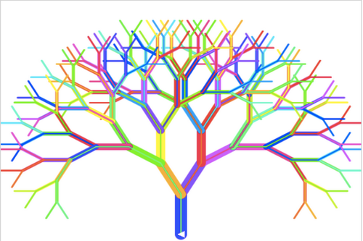
Dec
Lecture 11 - Decision Trees – Part 1
Hamed Hasheminia

Slide 2
Tree-Based Methods
Here we describe Tree-based methods for regression and Classification.
These involve Stratifying or Segmenting the predictor space into a number of simple regions
Since the set of splitting rules used to segment the predictor space can be summarized in a tree, these types of approaches are known as decision-tree methods.

Slide 3
Pros and Cons
Tree-based methods are simple and useful for interpretation.
However they typically are not as competitive as the best supervised learning approaches in terms of prediction accuracy.
Hence we also discuss bagging, random forests, and boosting in future lectures.

Slide 4
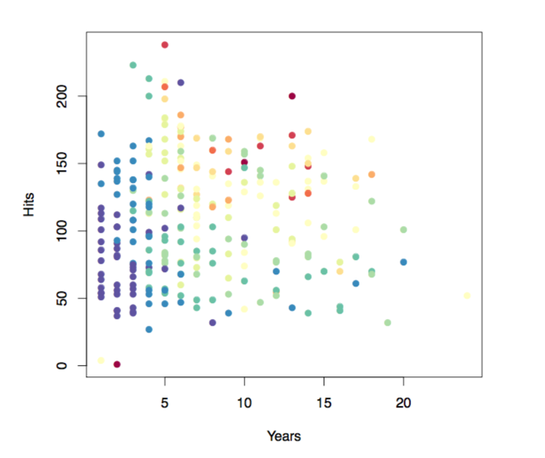
Decision Trees – Regression Problems
Salary in color-coded from low (blue, green) to high (yellow, red)
Notes:
Baseball data hits vs years color coded for salary

Slide 5
Decision Tree for these Data
Notes:
3 terminal nodes and 2 internal nodes

Slide 6
Details of Previous Figure
At a given internal node, the label (Variable < Constant) indicates the left-hand branch emanating from that split, and the right-hand branch corresponds to Variable >= Constant). For instance, the split at the top of the tree results in two large branches. The left-hand branch corresponds to Years < 4.5, and the right-hand branch corresponds to Years >= 4.5
The tree has two internal nodes and three terminal nodes, or leaves. The number in each leaf is the mean of the response for the observations that fall there.

Slide 7
Results
6.74
5.11
6
Notes:
For every class find the MSE for each class

Slide 8
Details of tree-building Process
We divide the predictor space — that is, the set of possible values for X₁, X₂,…, X_{p} — into J distinct and non-overlapping regions, R₁, R₂, . . . , R_{J} .
For every observation that falls into the region R_{j}, we make the same prediction, which is simply the mean of the response values for the training observations in R_{j}.
In theory, the regions could have any shape. However, we choose to divide the predictor space into high dimensional rectangles, or boxes, for simplicity and for ease of interpretation of the resulting predictive model.
Notes:
The X’s represent features

Slide 9
Notes:
The three dimensional image is the regions in top right and the mean of each

Slide 10
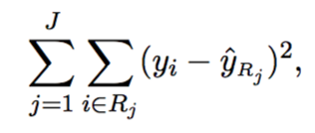

More details of the tree building process
The goal is to find boxes R₁,...,R_{j} that minimize the RSS, given by
Where is the mean response for the training observations within the j^{th} box.
Unfortunately, it is computationally infeasible to consider every possible partition of the feature space into J boxes.
Notes:
Must have more than 5 observations in the region or it becomes an NP hard problem

Slide 11
Greedy Algorithm

Slide 12
Greedy Algorithm

Slide 13
Greedy Algorithm

Slide 14
Top-Down Greedy Approach (also known as recursive binary splitting)
We first select the predictor X_{j} and the cutpoint s such that splitting the predictor space into the regions {X|X_{j} < s} and {X|X_{j} >= s} leads to the greatest possible reduction in RSS.
Notes:
Greedy: find best, then find best again. But don’t look at all possiblities to get overall “bests”. Take the short term best, then get the short term best from there. Only look at the choices right in front of you.

Slide 15
5.11
6.18
5.5
6
5
6.2
RSS = 1012
RSS = 953.2
RSS = 1091.1
6.4
6.23
5.9
5.9
5.4
5.1
RSS = 1031.1
RSS = 1022.1
RSS = 1076.1

Slide 16
Top-Down Greedy Approach (also known as recursive binary splitting)
Next, we repeat the process, looking for the best predictor and the best cutpoint in order to split the data further so as to minimize the RSS within each of the resulting regions.
However, this time, instead of splitting the entire predictor space, we split one of the two previously identified regions. We now have three regions.

Slide 18
6.74
5.11
6

Slide 19
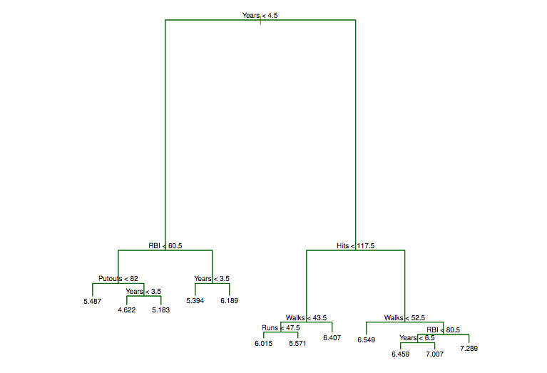
Cross-Validation

Slide 20
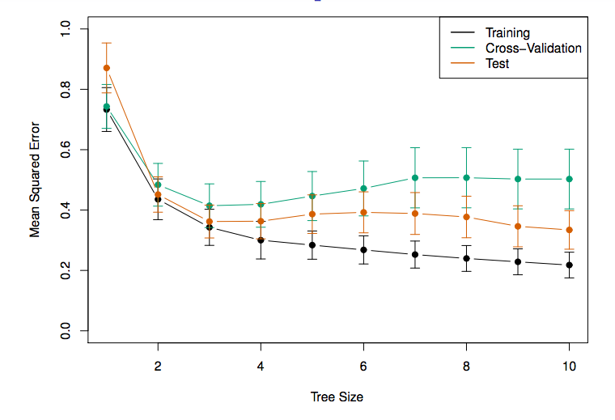

Slide 21
Classification Trees
Very similar to a regression tree, except that it is used to predict a qualitative response rather than a quantitative one.
For a classification tree, we predict that each observation belongs to the most commonly occurring class of training observations in the region to which it belongs.

Slide 22
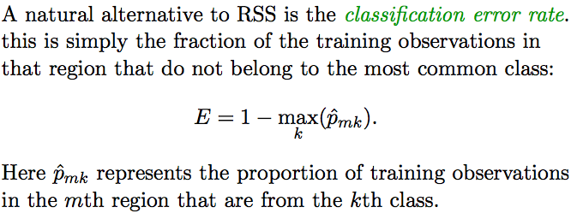
Details of classification trees

Slide 23
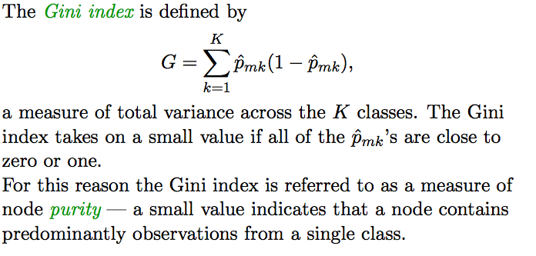
Gini Index
Notes:
For regression use RSS to find best regions, but for classification use Gini index when there are more than two classes: The gini index goes to 0 when everything is the same.

Slide 24
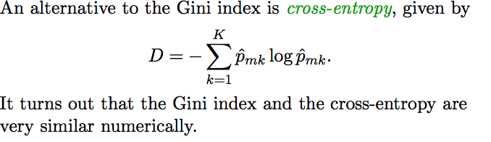
Cross-entropy

Slide 25
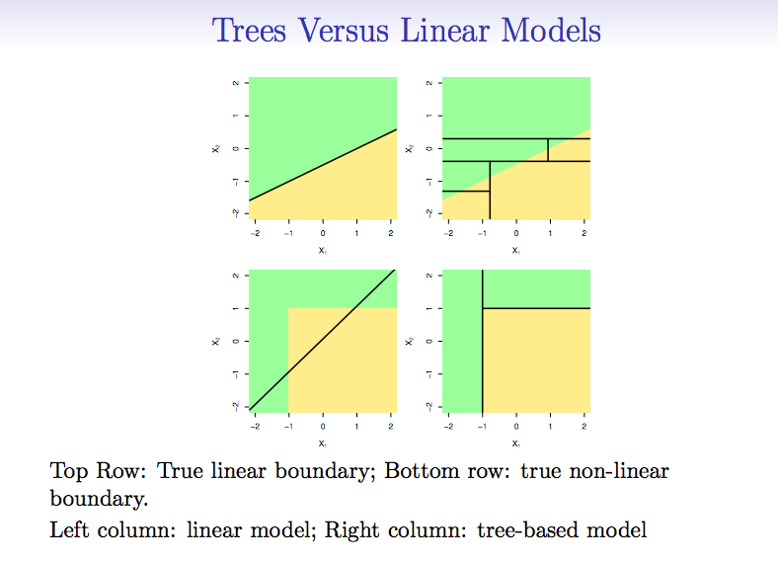

Slide 26
Summary
Decision trees are simple and interpretable models for regression and classification
However the are often not competitive with other methods in terms of prediction accuracy
Unfortunately, it is computationally infeasible to consider every possible partition of the feature space into J boxes. Therefore, we use top-down greedy approach to solve it.

Slide 27
What is next?
How can we increase predictability? (Bagging, Boosting, Random Forest)

